Slide 1
VIDHAI

Slide 2
MOTIVATION
As agriculture is the backbone of this nation, it is imperative for us to give more importance to farmers’ needs. Small scale farmers , who can’t afford enough money to buy large scale seed sowing machines face difficulties in regulating the seeds to be sowed at a particular depth and distance for various crops at different times of the year.

Slide 3
PROJECT OBJECTIVE
The main aim of this seed sowing machine is to
Help regulate small scale farmers in sowing seeds of different sizes and quantities at desired positions and particular depths mechanically .
Reduce the dependence on large machines or bullocks, used especially in horticulture.
Removal of residual weeds in the farming area.
Must provide an efficient and cost effective solution.

Slide 4
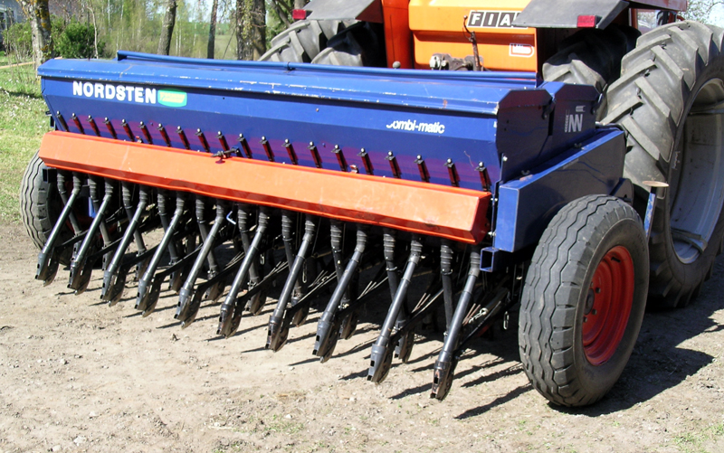
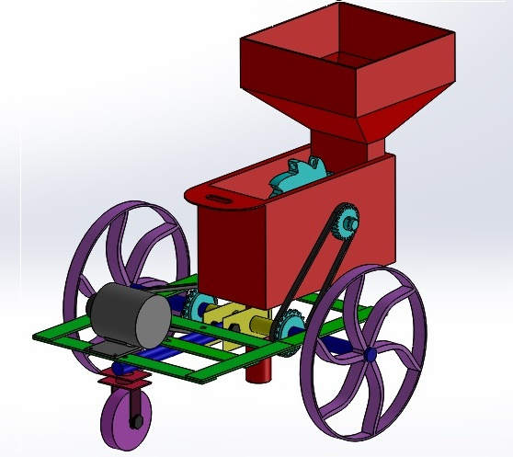
PRODUCTS IN MARKET
a) Machine 1 b) Machine 2

Slide 5
LIMITATIONS IN EXISTING MACHINES
Machine 1 –
Too expensive to be bought by small scale farmers.
As the land plot is small, there is no necessity to use this machine .
Machine 2-
Has a complex mechanism which makes it harder for the farmer to use the machine manually .
There is no option to change either the depth of sowing seed or the distance between them.

Slide 6
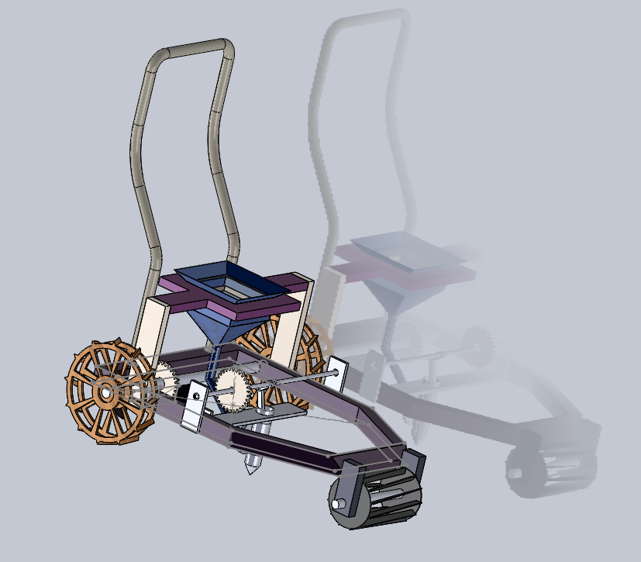
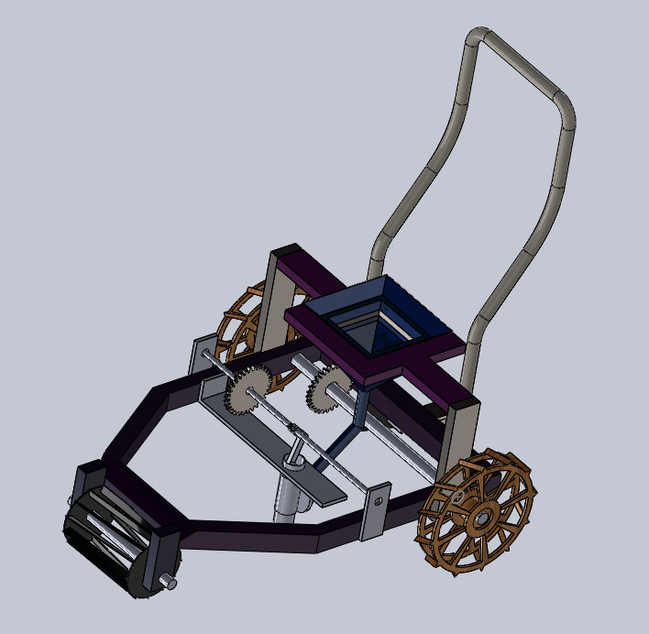
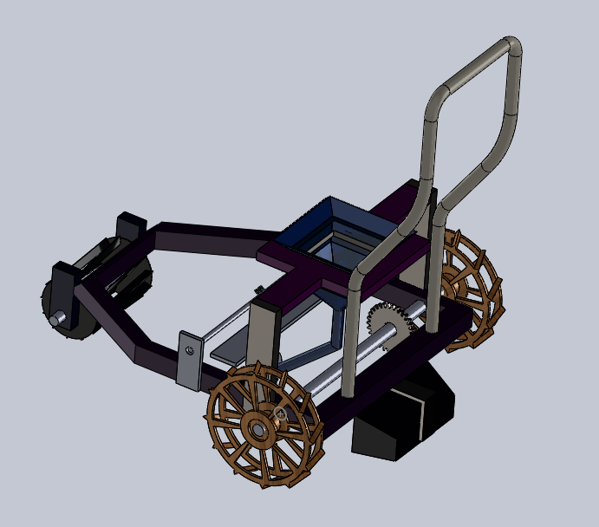
DESIGN OF OUR MODEL

Slide 7
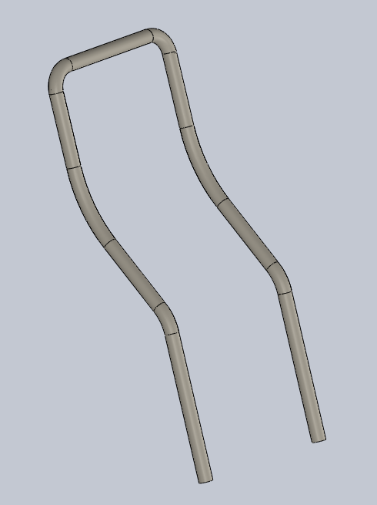
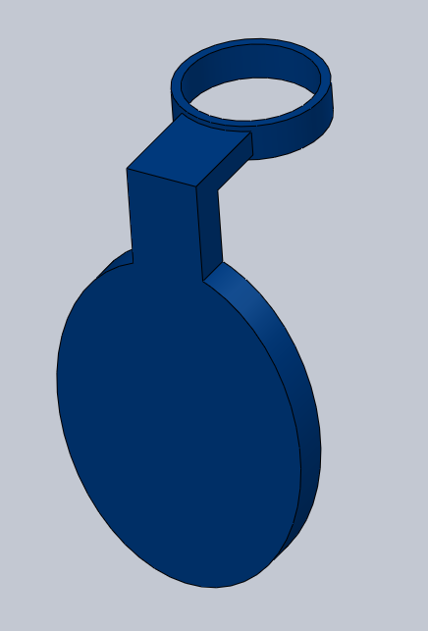
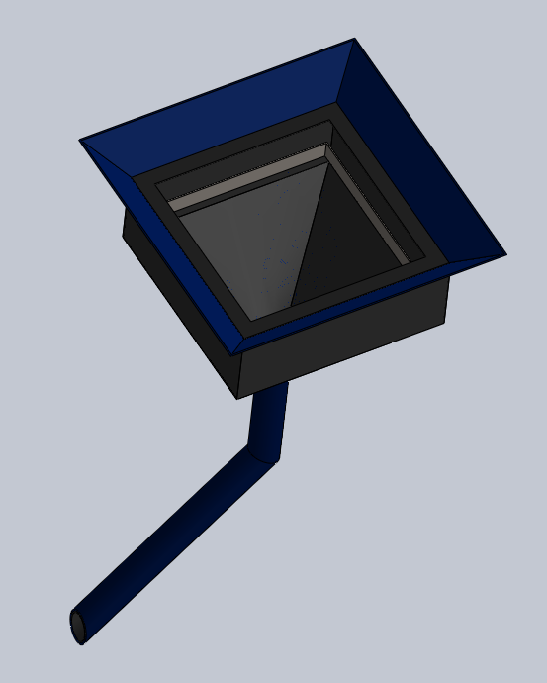
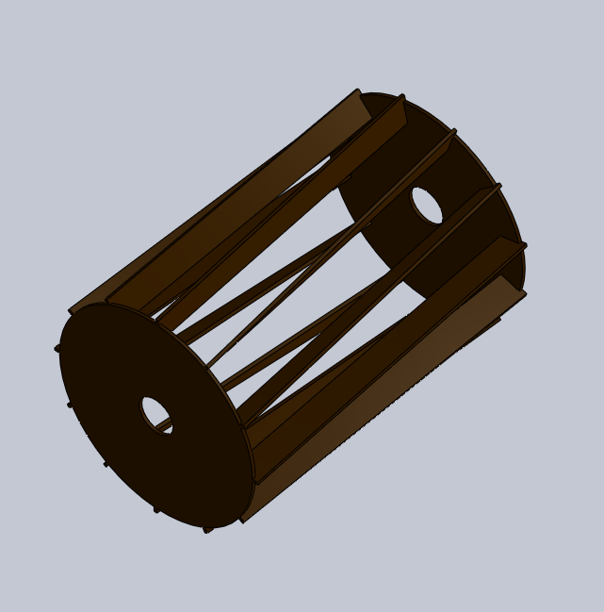
PARTS OF MODEL

Slide 8
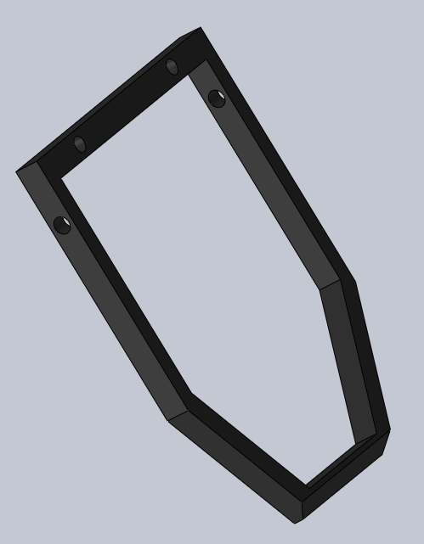
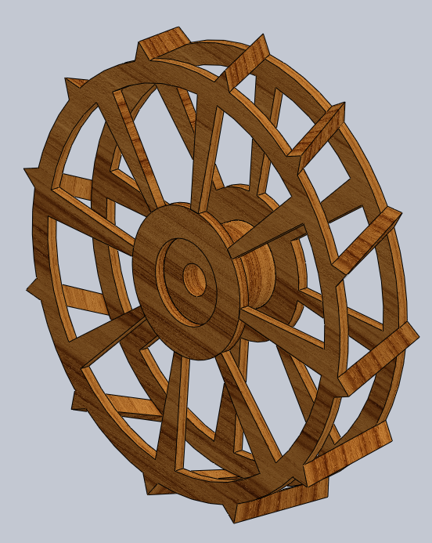
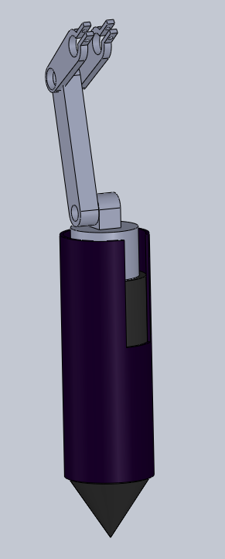
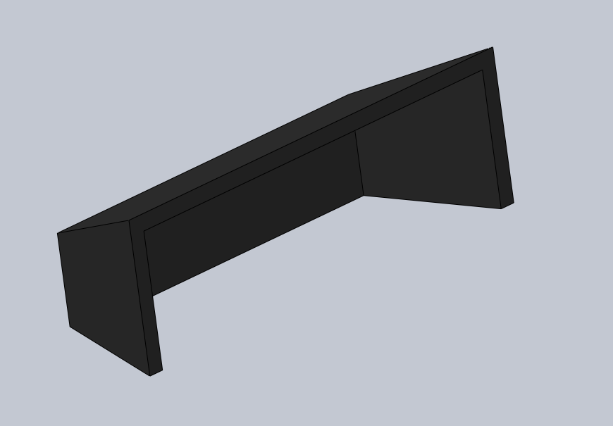
PARTS OF MODEL

Slide 9
HOW DOES IT WORK
The farmer manually pushes the machine along at a constant pace.
Power is transferred from wheel axle to power a simple slider crank mechanism, using sprockets and chains, which has a digger instead of the slider to dig holes on the ground at regular intervals.
Gears are provide to alter the distance between consecutively dug holes.
This slider is also extended to control a valve that controls the opening of the guide vane that holds the seeds to be released exactly at these holes.
A small polet is attached in the front . It has swirled blades to remove weeds and till the soil when it rotates. The polet is automatically rotated as the machine is pushed.
A secondary valve is provided between the seed container and the guide vane to control the number of seeds released for each rotation of the crank. This valve is controlled using sensors and servo motors.

Slide 10
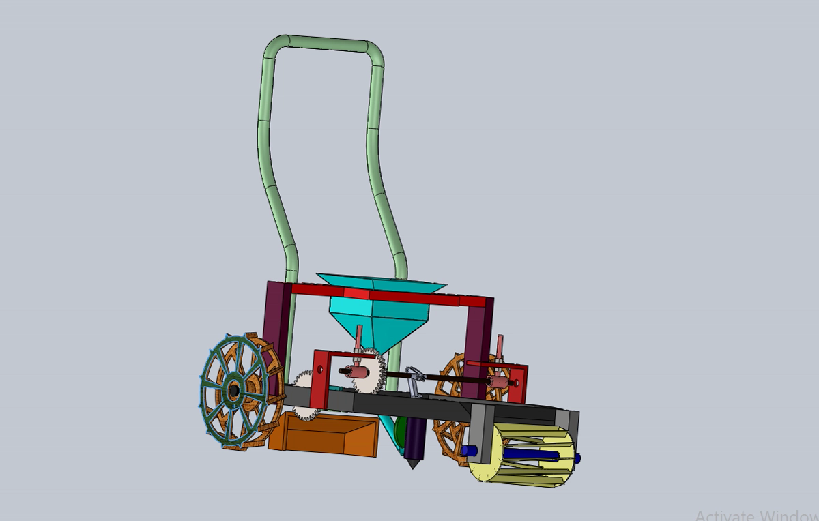
WORKING ANIMATION OF OUR MODEL

Slide 11
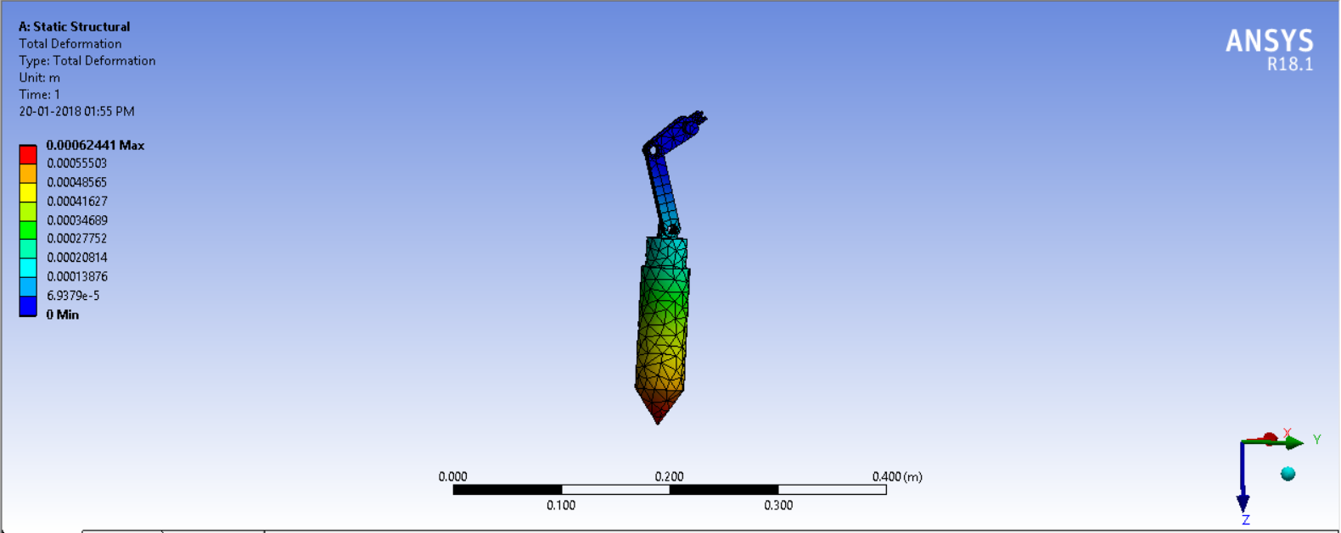
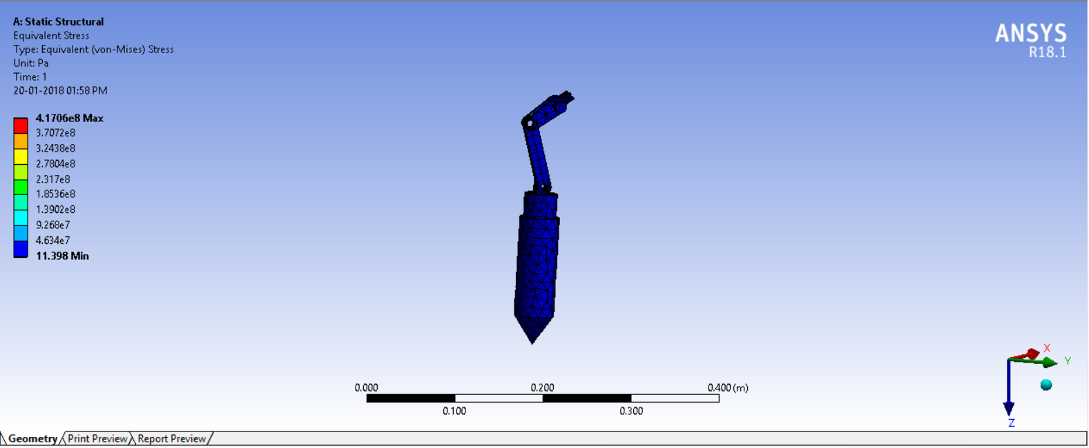
ANALYSIS OF DESIGN
a) Deformation b) Stress

Slide 12
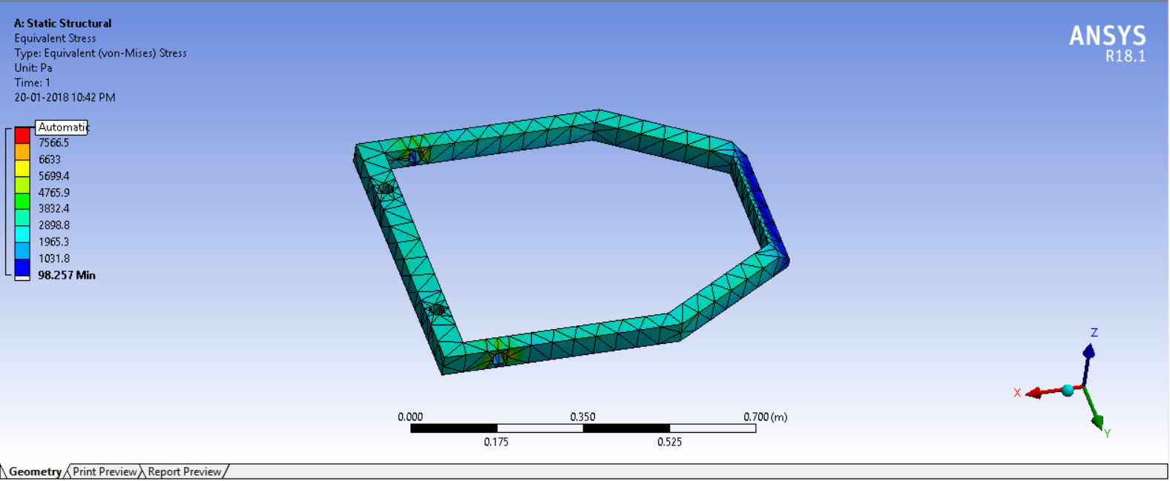
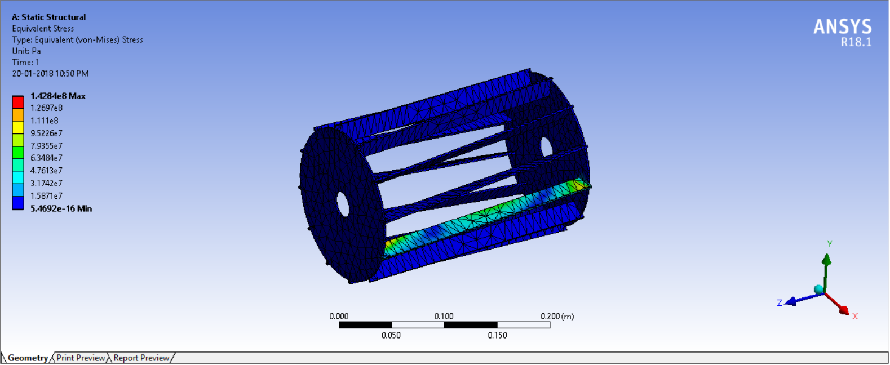
ANALYSIS OF OUR DESIGN

Slide 13
APPLICATIONS
Can be customised for multiple crops
Alternative farming technique in horticulture
Plantations
Nurseries and floriculture

Slide 14
UNIQUE SELLING POINTS
Sowing depth can be varied by adjusting the slider penetration length.
Distance between seeds sown can be varied.
Can be used for multiple crops by varying valve openings.

Slide 15
ADVANTANGES
Cost efficient
Eco friendly
Completely mechanised, no fuel required
Low maintenance
Single row seeding machine for all scale purpose.
Sowing is regulated.

Slide 16
COST ANALYSIS
Materials | Specifications | Expenditure (in Rs)
Tubes and Solid Members Square Tubes Circular Tubes Circular Solid Shaft | 2.5x2.5cm-3m 1.5inch dia-1m 12mm dia-1.5m | 80 (40/kg) 90 (45/kg) 250(44/kg)
Other metallic Components Mild Steel Sheet Mild Steel Plates | 3x3ft 3x3ft | 33 (33/kg) 35 (35/kg)
Electrical Components Infrared Sensor Battery Adruino Board | 1 - 9V DC Battery 1 - At – Mega 328p | 100 75 300
Other elements Wheels Ball Bearings Bicycle Bearings Bolts and Nuts | 2 * 175/piece 2 * 40/piece 2 * 50/piece | 350 80 50 210
Manufacturing and Other Costs |  | 500
Total Cost of Machine |  | 2700/unit

Slide 17
PROJECT TIMELINE
 | Starting Date | Completing date
Choosing the problem statement | November 20 | November 27
Background Research Work | November 27 | December 7
Ideation Phase | December 7 | December 20
Design Phase(solid works 17) | December 21 | January 02
Analysis Phase(Ansys 18.1) | January 04 | January 18
Fabrication process | January 22 | February 15
Project Completion |  | February 22 tentatively

